Slide 1
Baust Community Center

Slide 2


Bangladesh Army University of Science and Technology
Saidpur, Nilphamari
Submitted By:
Submitted To:
Student Name | Id
Md Sayadul Islam | 0802420405101103
Md Elias Ahmad | 0802420405101139
Momita Jaman Momo | 0802420105101101
Teacher’s Name | Designation
Shifa Tasmiah Tisha | Lecturer, Department of CSE
Md. Maskur Al Shal Sabil | Lecturer, Department of CSE

Slide 3
Project Objectives
Develop an online booking system for community centers.
Ensure real-time availability checking.
Provide admin panel for managing bookings and payments.
Provide an easy booking process for users.
Allow users to check availability before booking.
Enable admins to approve, cancel, or manage bookings.
Maintain a secure database of all bookings.

Slide 4
Problem & Solution
The Problem: Inefficient manual tracking, high risk of scheduling conflicts, and no central information hub for users to check facility availability.
The Solution: A centralized, web-based platform to streamline the booking process, provide real-time schedules, and offer efficient admin oversight.
Core Goal: To create a transparent, user-friendly, and manageable system that optimizes the use of community facilities.

Slide 5
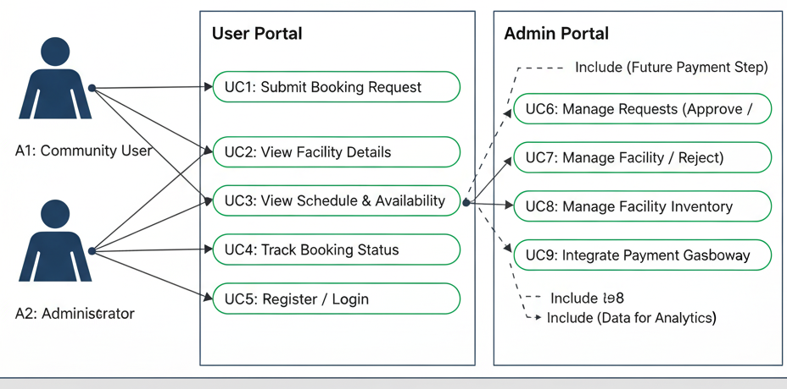
System Architecture

Slide 6
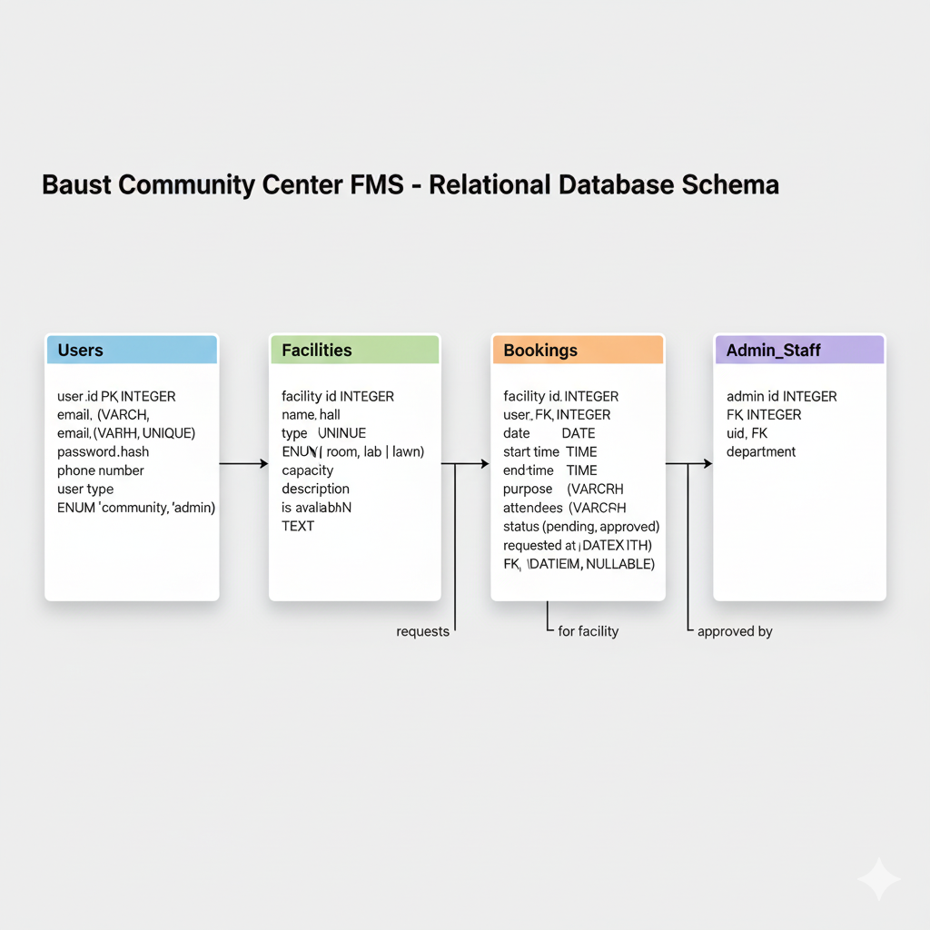
Relational Table

Slide 7
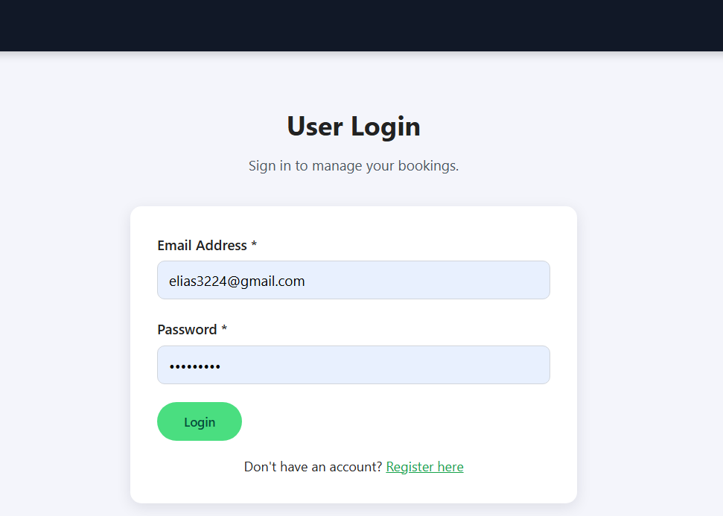
User Portal: Public Access
Key Features for Users:
✓
User Registration & Secure Login
✓
View Detailed Facility Information
✓
Browse Weekly Event Schedules
✓
Submit Booking Requests
✓
Check Personal Booking Status

Slide 8
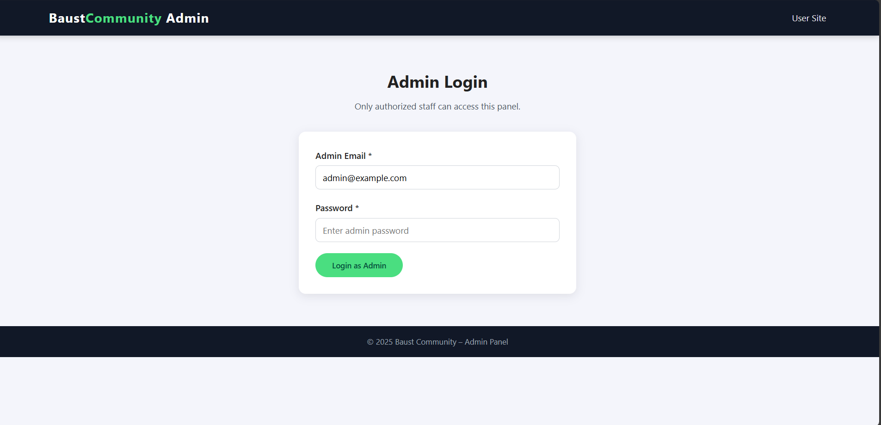
Admin Portal: Staff Access
Secure & Separate:
✓
Separate login panel for authorized staff.
✓
Protects management functions.
✓
Provides access to the central control dashboard.
✓
Links to the user site for navigation.

Slide 9







Available Facilities Showcase
Main Hall
Meeting Room
Computer Lab
Open Lawn
Capacity: 200 people. Suitable for conferences, cultural programs, and seminars.
Capacity: 20 people. Perfect for club meetings, small workshops, and group study.
Capacity: 30 people. Ideal for IT training, coding bootcamps, and digital literacy classes.
Capacity: 150 people. Suitable for fairs, exhibitions, and outdoor activities.

Slide 10
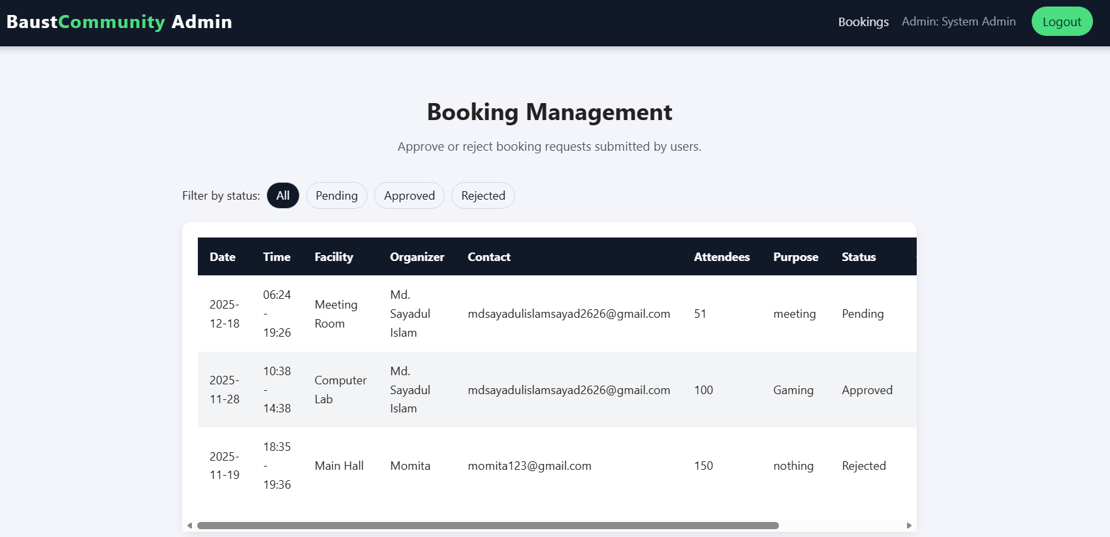
Core Feature: Booking Management
The admin dashboard is the system's control center. Staff can view all incoming booking requests in one clear, filterable table.
Full details are provided, including organizer, attendees, and purpose, allowing for informed and efficient decision-making.

Slide 11
Admin Actions & Workflow
Filter Bookings: Easily sort and view requests by status (All, Pending, Approved, Rejected).
Approve Requests: Confirms the booking, reserves the time slot, and updates the public schedule.
Reject Requests: Denies the booking and keeps the time slot open for other users.
Manage Schedule: Ensures no conflicts and optimizes the usage of all community facilities.

Slide 12
Sample Public Schedule
Day | Facility | Event | Time | Organizer
Sunday | Main Hall | Orientation Program | 10:00 AM - 1:00 PM | Student Affairs Office
Monday | Meeting Room | Debate Club Meeting | 4:00 PM - 6:00 PM | Debate Club
Tuesday | Computer Lab | Web Development Workshop | 2:00 PM - 5:00 PM | IT Society
Wednesday | Open Lawn | Cultural Night Rehearsal | 5:00 PM - 8:00 PM | Cultural Club
Thursday | Main Hall | Research Seminar | 11:00 AM - 2:00 PM | Research Cell

Slide 13






Technology Stack
Frontend
Backend
Database
HTML5, CSS3, and JavaScript for a responsive and interactive user interface.
Node.js with Express for a fast, scalable, and efficient server-side application.
MySQL for reliable, structured, and secure data storage and management.

Slide 14
Current Limitations
Manual Approval: Bookings are not instant and require manual administrator approval, creating a potential delay.
Web-Only Access: The system is currently only accessible via a web browser and lacks a dedicated mobile app.
No Payment Integration: Lacks a built-in system for handling payments or deposits for paid facility use.
Basic Notifications: The current system does not feature automated email or SMS reminders for bookings.

Slide 15
Future Scope
Mobile App: Develop native Android and iOS apps for on-the-go booking and management.
Automated Notifications: Implement email and SMS reminders for upcoming bookings and status changes.
Online Payment Gateway: Integrate a secure payment system for paid events or facility deposits.
Analytics Dashboard: Add a reporting module for admins to track facility usage and popular time slots.

Slide 16
Thank You
Questions & Answers

